Slide 1



Principles of model fitting
Section C
HARTLEY LAB
“All models are wrong, but some are useful”
George E. P. Box
Naiti Bhatt | Greer Bizzell-Hatcher | Magda Dubois

Slide 2

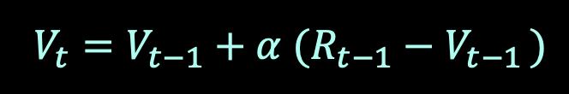
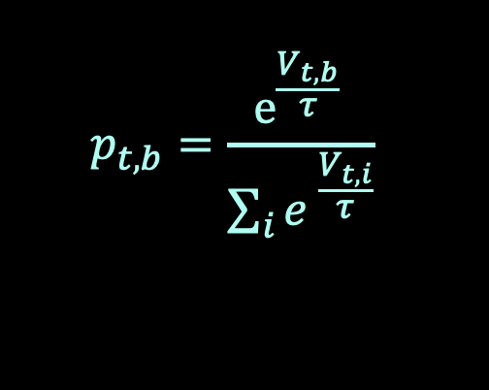
Reminder
Section C | Modelling and model fitting
HARTLEY LAB
Task:
Need to choose between 2 bandits
Model:
Estimated value of each bandit on trial t (Rescorla-Wagner learning):
Probability of choosing bandit b on trial t (Softmax function)
Naiti Bhatt | Greer Bizzell-Hatcher | Magda Dubois
Notes:
Just a reminder we have a task, in which participants need to choose between 2 bandits, a purple and an orange one, in order to maximize reward
Our model is made of 2 equations, in the first one we estimate ...

Slide 3
Reminder
Section C | Modelling and model fitting
HARTLEY LAB
Task:
Need to choose between 2 bandits
Model:
Estimated value of each bandit on trial t (Rescorla-Wagner learning):
Probability of choosing bandit b on trial t (Softmax function)
learning rate
Parameters to estimate
(free parameters)
temperature
Naiti Bhatt | Greer Bizzell-Hatcher | Magda Dubois
Notes:
As explained in the previous section, there are 2 parameters that we need to estimate, or what we call FREE PARAMETERS. There’s is alpha, the learning rate
And tau, the softmax temperature, which controls to which extent the choice depends on the values, or in the other words the amount of noise in the decision.

Slide 4
Developing a computational model
Section C | Modelling and model fitting
HARTLEY LAB
Develop task and model(s)
2. Fit model(s) to data
Task design
Model design
Model selection
Parameter estimation
3. Validate results
Model recovery and comparison
Parameter recovery
Posterior predictive checks
Tricia Seow | Samuel Hewitt | Noam Goldway
Notes:
A quick reminder for the overall flow of the workshop, we are now at the second section:

Slide 5
Developing a computational model
Section C | Modelling and model fitting
HARTLEY LAB
2. Fit model(s) to data
Model selection
Parameter estimation
Tricia Seow | Samuel Hewitt | Noam Goldway
Notes:
Focusing on fitting model to the data. We have now selected our model, and we now want to estimate its parameters.

Slide 6
What we will cover:
Section C | Modelling and model fitting
HARTLEY LAB
What is model fitting?
Model fitting using maximum likelihood estimation (MLE)
Optimization methods for MLE: grid search and gradient search
Naiti Bhatt | Greer Bizzell-Hatcher | Magda Dubois
Notes:
This is what we will cover in this section,

Slide 7
What we will cover:
Section C | Modelling and model fitting
HARTLEY LAB
What is model fitting?
Model fitting using maximum likelihood estimation (MLE)
Optimization methods for MLE: grid search and gradient search
Naiti Bhatt | Greer Bizzell-Hatcher | Magda Dubois

Slide 8
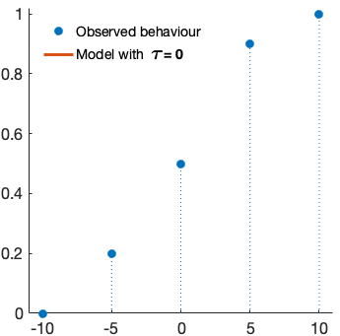
What is model fitting?
Section C | Modelling and model fitting
HARTLEY LAB
We have:
Participant data (behaviour on a task)
Ratio of trials where purple bandit is chosen
Bandits’ value difference (purple - orange)
-
Naiti Bhatt | Greer Bizzell-Hatcher | Magda Dubois
Notes:
Right now we have 2 things. We have the participant data, which is the behaviour we observed on the bandit task. So here on the plot we have the difference between the purple bandits value and the orange bandits value. And on the y-axis the ratio of trials where the purple bandit was chosen, and like explained in the previous section, the higher the value of the purple bandit, as compared to the orange one, the more it is chosen, and similarly, the higher the value of the orange bandit as compared to the purple one, the less the purple bandit is chosen.

Slide 9
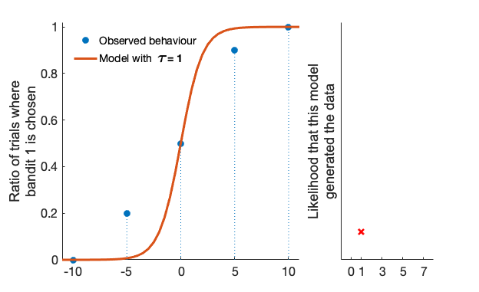
What is model fitting?
Section C | Modelling and model fitting
HARTLEY LAB
We have:
Participant data (behaviour on a task)
A model with unknown parameters
Ratio of trials where purple bandit is chosen
Bandits’ value difference (purple - orange)
-
Naiti Bhatt | Greer Bizzell-Hatcher | Magda Dubois
Notes:
And we also have a model with unknown parameters. Here for visualisation purposes, let’s imagine that we only have one parameter, so this temperature tau here which, as you can see from the animation, controls the shape of this softmax.

Slide 10
What is model fitting?
Section C | Modelling and model fitting
HARTLEY LAB
We have:
Participant data (behaviour on a task)
A model with unknown parameters
Goal:
Determine values of parameters that make the model behave as similar to the data as possible, i.e., fit the model to the data
Ratio of trials where purple bandit is chosen
Bandits’ value difference (purple - orange)
-
Naiti Bhatt | Greer Bizzell-Hatcher | Magda Dubois
Notes:
And so we have those 2 things and our goal now is to determine values of the parameters …
And this is what we mean by fitting the model to the data.

Slide 11
What we will cover:
Section C | Modelling and model fitting
HARTLEY LAB
What is model fitting?
Model fitting using maximum likelihood estimation (MLE)
Optimization methods for MLE: grid search and gradient search
Naiti Bhatt | Greer Bizzell-Hatcher | Magda Dubois

Slide 12
Section C | Modelling and model fitting
Model fitting
HARTLEY LAB
Linear regression case:
Least Square Estimation (e.g. root mean square error)
Notes:
As we saw in the 1st section of this workshop, in the case of a linear regression, least square estimation is commonly used, for example the root mean square error.

Slide 13
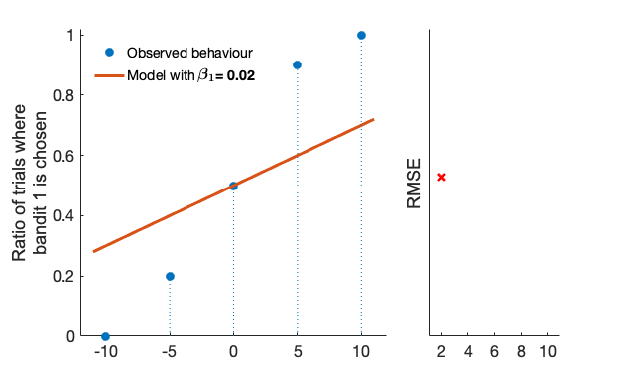
Section C | Modelling and model fitting
Model fitting
HARTLEY LAB
Linear regression case:
Least Square Estimation (e.g. root mean square error)
Ratio of trials where purple bandit is chosen
Bandits’ value difference
(purple - orange)
-
Notes:
Let’s say that we would want to fit our data with a linear function, it would look something like that, with the slope controlled by this parameter beta 1.

Slide 14
Section C | Modelling and model fitting
Model fitting
HARTLEY LAB
Linear regression case:
Least Square Estimation (e.g. root mean square error)
RMSE computation
1. For each point, compute the difference between the observation and the prediction
Ratio of trials where purple bandit is chosen
Bandits’ value difference
(purple - orange)
-
Notes:
And in order to find the slope which fits the data best, we can compute the root mean square errors. First, for each point we compute the difference between the observation (in blue) and the prediction (in red)

Slide 15
Section C | Modelling and model fitting
Model fitting
HARTLEY LAB
Linear regression case:
Least Square Estimation (e.g. root mean square error)
RMSE computation
1. For each point, compute the difference between the observation and the prediction
2. Square it
Ratio of trials where purple bandit is chosen
Bandits’ value difference
(purple - orange)
-
Notes:
We square this difference, to not have any issues with the signs

Slide 16
Section C | Modelling and model fitting
Model fitting
HARTLEY LAB
Linear regression case:
Least Square Estimation (e.g. root mean square error)
RMSE computation
1. For each point, compute the difference between the observation and the prediction
2. Square it
3. Sum all the points
Ratio of trials where purple bandit is chosen
Bandits’ value difference
(purple - orange)
-
Notes:
We sum over all observations, so over all the blue points

Slide 17
Section C | Modelling and model fitting
Model fitting
HARTLEY LAB
Linear regression case:
Least Square Estimation (e.g. root mean square error)
RMSE computation
1. For each point, compute the difference between the observation and the prediction
2. Square it
3. Sum all the points
4. Take the root
Ratio of trials where purple bandit is chosen
Bandits’ value difference
(purple - orange)
Values of
(x10e-2)
-
Notes:
We take the root and this gives us this red cross here. So a certain RMSE value for the model which has a beta_1 of 0.02

Slide 18

Section C | Modelling and model fitting
Model fitting
HARTLEY LAB
Linear regression case:
Least Square Estimation (e.g. root mean square error)
RMSE computation
1. For each point, compute the difference between the observation and the prediction
2. Square it
3. Sum all the points
4. Take the root
Do the same for all values of beta
Ratio of trials where purple bandit is chosen
Bandits’ value difference
(purple - orange)
Values of
(x10e-2)
-
Notes:
We then do this for the different values of beta1 that we are comparing. So from the animation here, you can see that for each different beta_1 value, the model changes and is associated to a different RMSE value.

Slide 19
Section C | Modelling and model fitting
Model fitting
HARTLEY LAB
Linear regression case:
Least Square Estimation (e.g. root mean square error)
RMSE computation
1. For each point, compute the difference between the observation and the prediction
2. Square it
3. Sum all the points
4. Take the root
Do the same for all values of beta
→ select the one with lowest RMSE
Ratio of trials where purple bandit is chosen
Bandits’ value difference
(purple - orange)
Values of
(x10e-2)
-
Notes:
And then the best fit, is the one with the parameter value associated to the lowest RMSE, so here a beta_1 of 0.06

Slide 20
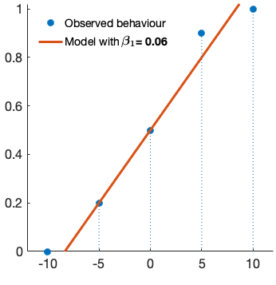
Section C | Modelling and model fitting
Model fitting
HARTLEY LAB
Linear regression case:
Least Square Estimation (e.g. root mean square error)
RMSE computation
1. For each point, compute the difference between the observation and the prediction
2. Square it
3. Sum all the points
4. Take the root
Do the same for all values of beta
→ select the one with lowest RMSE
Ratio of trials where purple bandit is chosen
Linear function
Bandits’ value difference
(purple - orange)
-
Notes:
So the function that we see here. This is a good method, if we assume that the underlying model is linear, like this red line, but in many cases, it makes more sense to generalise to more complex functions, so for example here we might want something that looks more like a sigmoid function.

Slide 21
Section C | Modelling and model fitting
Model fitting
HARTLEY LAB
General case (e.g. logistic regression):
Maximum Likelihood Estimation (i.e. likelihood that the data is generated from the model)
Notes:
And so in the more general case, for example in the case of a logistic regression, like in the classification problem we have here,
we can use the Maximum Likelihood Estimation. And the concept here is similar to least square estimation, but instead of minimizing an error, we maximise the likelihood that the data was generated from a model

Slide 22
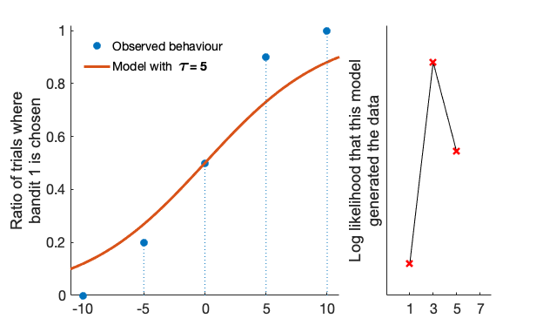
Section C | Modelling and model fitting
Model fitting
HARTLEY LAB
General case (e.g. logistic regression):
Maximum Likelihood Estimation (i.e. likelihood that the data is generated from the model)
Ratio of trials where purple bandit is chosen
Bandits’ value difference
(purple - orange)
-
Notes:
Let’s see how this would look. We take the same behaviour, but this time we are not trying to fit it to linear model, but to a logistic model, which has those curvatures here at both ends controlled by the parameter tau.

Slide 23
Section C | Modelling and model fitting
Model fitting
HARTLEY LAB
General case (e.g. logistic regression):
Maximum Likelihood Estimation (i.e. likelihood that the data is generated from the model)
MLE computation
1. For each point, compute likelihood that it occurred under the specific model, taking into account N of trials
Ratio of trials where purple bandit is chosen
Bandits’ value difference
(purple - orange)
-
Notes:
Similarly to before, in order to find the parameter which fits the data best, we can compute maximum likelihood estimation. First, for each point we compute the likelihood that it occured under the speicifc model, taking into accoutn the number of trials

Slide 24
Section C | Modelling and model fitting
Model fitting
HARTLEY LAB
General case (e.g. logistic regression):
Maximum Likelihood Estimation (i.e. likelihood that the data is generated from the model)
MLE computation
1. For each point, compute likelihood that it occurred under the specific model, taking into account N of trials
Ratio of trials where purple bandit is chosen
How likely?
Bandits’ value difference
(purple - orange)
-
Notes:
As an example, let’s say that we are looking at this point here, and we want to see how likely it is to occur given this red model

Slide 25
Section C | Modelling and model fitting
Model fitting
HARTLEY LAB
General case (e.g. logistic regression):
Maximum Likelihood Estimation (i.e. likelihood that the data is generated from the model)
MLE computation
1. For each point, compute likelihood that it occurred under the specific model, taking into account N of trials
Ratio of trials where purple bandit is chosen
e.g. N trials = 5
How likely?
Choice:
1x purple, 4x yellow
Bandits’ value difference
(purple - orange)
-
Notes:
Let’s imagine there were 5 trials on this task, on this specific condition. This ratio of 0.2 means that the purple bandit was chosen once, and the yellow bandit, 4 times.

Slide 26
Section C | Modelling and model fitting
Model fitting
HARTLEY LAB
General case (e.g. logistic regression):
Maximum Likelihood Estimation (i.e. likelihood that the data is generated from the model)
MLE computation
1. For each point, compute likelihood that it occurred under the specific model, taking into account N of trials
Ratio of trials where purple bandit is chosen
e.g. N trials = 5
How likely?
Choice:
1x purple, 4x yellow
Likelihood of this occurring:
P(b1) * P( ) * P( ) * P( ) * P( )
Bandits’ value difference
(purple - orange)
-
Notes:
So if we calculate the likelihood of this occurring given the red model, we would have the probability of the purple bandit times the probability of the yellow bandit 4 times,

Slide 27
Section C | Modelling and model fitting
Model fitting
HARTLEY LAB
General case (e.g. logistic regression):
Maximum Likelihood Estimation (i.e. likelihood that the data is generated from the model)
MLE computation
1. For each point, compute likelihood that it occurred under the specific model, taking into account N of trials
Ratio of trials where purple bandit is chosen
e.g. N trials = 5
0.25
How likely?
Choice:
1x purple, 4x yellow
Likelihood of this occurring:
P(b1) * P( ) * P( ) * P( ) * P( )
= 0.25 * (1-0.25)^4 = 0.08
Bandits’ value difference
(purple - orange)
-
Notes:
Under this specific model we are looking at right now, the probability of the purple is 0.25, and then becase there are only 2 options, if the purple bandit is not selected, it means that the yellow bandit is selected, so the probability of the yellow, is simply 1 minus that, and to the power of 4 becaue it occurred 4 times, which gives us 0.08 in this example. And you can see that this likelihood value is quite small, and this is becaue we multiply mane probabilities which are always smaller or equal to 1, so the more trials, the lower this number

Slide 28
Section C | Modelling and model fitting
Model fitting
HARTLEY LAB
General case (e.g. logistic regression):
Maximum Likelihood Estimation (i.e. likelihood that the data is generated from the model)
MLE computation
1. For each point, compute likelihood that it occurred under the specific model, taking into account N of trials
e.g. N trials = 25
Ratio of trials where purple bandit is chosen
0.25
How likely?
Choice:
5x purple, 20x yellow
Likelihood of this occurring:
Bandits’ value difference
(purple - orange)
-
Notes:
For example if we had 25 trials

Slide 29
Section C | Modelling and model fitting
Model fitting
HARTLEY LAB
General case (e.g. logistic regression):
Maximum Likelihood Estimation (i.e. likelihood that the data is generated from the model)
MLE computation
1. For each point, compute likelihood that it occurred under the specific model, taking into account N of trials
e.g. N trials = 25
Ratio of trials where purple bandit is chosen
How likely?
Choice:
5x purple, 20x yellow
Likelihood of this occurring:
P( )^5 * P( )^20
= 0.25^5 * (1-0.25)^20 = 3x10e-6
Bandits’ value difference
(purple - orange)
-
Notes:
We would have the probability of the purple to the power of 5, and the probability of the yellow to the power of 20, and this would give use which is 10 to the power of minus 6, so imagine with even more trials.

Slide 30
Section C | Modelling and model fitting
Model fitting
HARTLEY LAB
General case (e.g. logistic regression):
Maximum Likelihood Estimation (i.e. likelihood that the data is generated from the model)
MLE computation
1. For each point, compute likelihood that it occurred under the specific model, taking into account N of trials
2. Take the log of the probability
e.g. N trials = 25
Ratio of trials where purple bandit is chosen
How likely?
Choice:
5x purple, 20x yellow
Likelihood of this occurring:
P( )^5 * P( )^20
= 0.25^5 * (1-0.25)^20 = 3x10e-6
e.g.
log(3x10e-6)
= -12.6
Bandits’ value difference
(purple - orange)
-
Notes:
So in order to avoid problems with very small values, a little hack is to take the logarithm of this likelihood. So for example here the log of this small value, would give us -12.6
What this funciton does is that it converts numbers smaller than 1 to negative larger numbers, and also, as a little reminder

Slide 31
Section C | Modelling and model fitting
Model fitting
HARTLEY LAB
General case (e.g. logistic regression):
Maximum Likelihood Estimation (i.e. likelihood that the data is generated from the model)
MLE computation
1. For each point, compute likelihood that it occurred under the specific model, taking into account N of trials
2. Take the log of the probability
e.g. N trials = 25
Ratio of trials where purple bandit is chosen
How likely?
Choice:
5x purple, 20x yellow
log(ab) = log(a) + log(b)
Likelihood of this occurring:
P( )^5 * P( )^20
= 0.25^5 * (1-0.25)^20 = 3x10e-6
e.g.
log(3x10e-6)
= -12.6
Bandits’ value difference
(purple - orange)
-
Notes:
And this is related to a special characteristics of the log fct, which is that the log of a product is actually the sum of the individual logs, so instead of constantly multiplying by small numbers, we just add those individual log probabilities.

Slide 32
Section C | Modelling and model fitting
Model fitting
HARTLEY LAB
General case (e.g. logistic regression):
Maximum Likelihood Estimation (i.e. likelihood that the data is generated from the model)
MLE computation
1. For each point, compute likelihood that it occurred under the specific model, taking into account N of trials
2. Take the log of the probability
3. Sum over all points
Ratio of trials where purple bandit is chosen
Bandits’ value difference
(purple - orange)
Values of
-
Notes:
We do this for each observation, so for each blue point here, and we sum those log likelihoods, which gives us this red cross here, so a certain log likelihood value for a tau of 5.

Slide 33
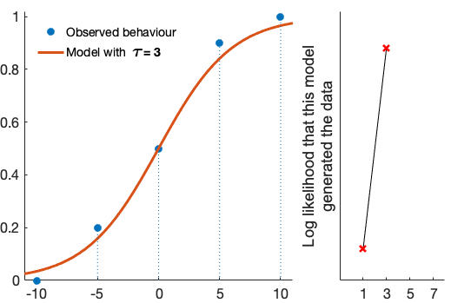
Section C | Modelling and model fitting
Model fitting
HARTLEY LAB
General case (e.g. logistic regression):
Maximum Likelihood Estimation (i.e. likelihood that the data is generated from the model)
MLE computation
1. For each point, compute likelihood that it occurred under the specific model, taking into account N of trials
2. Take the log of the probability
3. Sum over all points
Do the same for all values of tau
Ratio of trials where purple bandit is chosen
Bandits’ value difference
(purple - orange)
Values of
-
Notes:
Similarly to RMSE, we do this for different values of tau, as you can see in this animation, and this allows us to plot this log likelihood function on the right

Slide 34
Section C | Modelling and model fitting
Model fitting
HARTLEY LAB
General case (e.g. logistic regression):
Maximum Likelihood Estimation (i.e. likelihood that the data is generated from the model)
MLE computation
1. For each point, compute likelihood that it occurred under the specific model, taking into account N of trials
2. Take the log of the probability
3. Sum over all points
Do the same for all values of tau
→ select the one with highest LL
Ratio of trials where purple bandit is chosen
Bandits’ value difference
(purple - orange)
Values of
-
Notes:
And we simply choose the parameter associated to the highest log likelihood value, which would be 3 here.
This was a simple example where are only comparing 4 different values of tau.

Slide 35
Maximum Likelihood Estimation
Section C | Modelling and model fitting
HARTLEY LAB
Goal: find the maximum likelihood estimate over many different parameter combinations
Naiti Bhatt | Greer Bizzell-Hatcher | Magda Dubois
Notes:
But in general we want to find the MLE over many different parameter combinations, so many more values of tau, but also over many values of alpha for example here or even additional parameters.

Slide 36
Maximum Likelihood Estimation
Section C | Modelling and model fitting
HARTLEY LAB
Goal: find the maximum likelihood estimate over many different parameter combinations
Ways to do it:
1. Analytically
2. Naive search methods (e.g. grid search, random search, genetic algorithms)
3. Gradient-based methods (e.g. gradient descent, stochastic gradient descent)
4. Bayesian methods
Naiti Bhatt | Greer Bizzell-Hatcher | Magda Dubois
Notes:
There are different ways to do it, we mention some of them here, which we split here in 4 categories
I will briefly introduce the concepts, and Naiti will then go throguh 2 specific ones in more details in the last part of this section.

Slide 37
Maximum Likelihood Estimation
Section C | Modelling and model fitting
HARTLEY LAB
Goal: find the maximum likelihood estimate over many different parameter combinations
Ways to do it:
1. Analytically
→ Take the derivative of the likelihood fct, solve it for your parameters
2. Naive search methods (e.g. grid search, random search, genetic algorithms)
3. Gradient-based methods (e.g. gradient descent, stochastic gradient descent)
4. Bayesian methods
Naiti Bhatt | Greer Bizzell-Hatcher | Magda Dubois
Notes:
Analytically…

Slide 38
Maximum Likelihood Estimation
Section C | Modelling and model fitting
HARTLEY LAB
Goal: find the maximum likelihood estimate over many different parameter combinations
Ways to do it:
1. Analytically => often not possible
→ Take the derivative of the likelihood fct, solve it for your parameters
2. Naive search methods (e.g. grid search, random search, genetic algorithms)
3. Gradient-based methods (e.g. gradient descent, stochastic gradient descent)
4. Bayesian methods
Naiti Bhatt | Greer Bizzell-Hatcher | Magda Dubois
Notes:
Often not possible in practice, because the functions are not differentiable, for example with RL models

Slide 39
Maximum Likelihood Estimation
Section C | Modelling and model fitting
HARTLEY LAB
Goal: find the maximum likelihood estimate over many different parameter combinations
Ways to do it:
1. Analytically => often not possible
→ Take the derivative of the likelihood fct, solve it for your parameters
2. Naive search methods (e.g. grid search, random search, genetic algorithms)
3. Gradient-based methods (e.g. gradient descent, stochastic gradient descent)
4. Bayesian methods
Optimization methods
Naiti Bhatt | Greer Bizzell-Hatcher | Magda Dubois
Notes:
So we have to do it numerically using optimization methods

Slide 40
Maximum Likelihood Estimation
Section C | Modelling and model fitting
HARTLEY LAB
Goal: find the maximum likelihood estimate over many different parameter combinations
Ways to do it:
1. Analytically => often not possible
→ Take the derivative of the likelihood fct, solve it for your parameters
2. Naive search methods (e.g. grid search, random search, genetic algorithms)
→ Compute likelihood for different parameter values, take the largest
3. Gradient-based methods (e.g. gradient descent, stochastic gradient descent)
4. Bayesian methods
Optimization methods
Naiti Bhatt | Greer Bizzell-Hatcher | Magda Dubois
Notes:
2. Naive search methods, for ex grid search, random search or genetic algoriths.
So here you compute the likelihood for different parameter values, and then you simply select the set of parameters associated to the largest likelihood.so a bit like in the example i showed you before but for many more values and parameters.
And so this parameter set can be chosen in a very systematic way, like in grid search where you evaluate every combination of a grid, or they can be selected randomly like in random search, or in ways inspired from evolution like in genetic algorithms.

Slide 41
Maximum Likelihood Estimation
Section C | Modelling and model fitting
HARTLEY LAB
Goal: find the maximum likelihood estimate over many different parameter combinations
Ways to do it:
1. Analytically => often not possible
→ Take the derivative of the likelihood fct, solve it for your parameters
2. Naive search methods (e.g. grid search, random search, genetic algorithms) => expensive
→ Compute likelihood for different parameter values, take the largest
3. Gradient-based methods (e.g. gradient descent, stochastic gradient descent)
4. Bayesian methods
Optimization methods
Naiti Bhatt | Greer Bizzell-Hatcher | Magda Dubois
Notes:
But overall the problem is that those methods don’t take advantage of the characteristics of the model to guide their search process, so they need to compute many different combinations, which makes them very expensive, and infeasible with large number especially in the case of grid search,

Slide 42
Maximum Likelihood Estimation
Section C | Modelling and model fitting
HARTLEY LAB
Goal: find the maximum likelihood estimate over many different parameter combinations
Ways to do it:
1. Analytically => often not possible
→ Take the derivative of the likelihood fct, solve it for your parameters
2. Naive search methods (e.g. grid search, random search, genetic algorithms) => expensive
→ Compute likelihood for different parameter values, take the largest
3. Gradient-based methods (e.g. gradient descent, stochastic gradient descent)
→ Starts from an initial guess and moves to the direction of greatest descent
4. Bayesian methods
Optimization methods
Naiti Bhatt | Greer Bizzell-Hatcher | Magda Dubois
Notes:
Then we have gradient-based methods, for example…
They starts from an initial random guess and move to the direction of greatest descent, according to the model. Greatest descent in the case of minimization, or to the direction of greatest ascent in the case of maximization

Slide 43
Maximum Likelihood Estimation
Section C | Modelling and model fitting
HARTLEY LAB
Goal: find the maximum likelihood estimate over many different parameter combinations
Ways to do it:
1. Analytically => often not possible
→ Take the derivative of the likelihood fct, solve it for your parameters
2. Naive search methods (e.g. grid search, random search, genetic algorithms) => expensive
→ Compute likelihood for different parameter values, take the largest
3. Gradient-based methods (e.g. gradient descent, stochastic gradient descent) => local minimas
→ Starts from an initial guess and moves to the direction of greatest descent
4. Bayesian methods
Optimization methods
Naiti Bhatt | Greer Bizzell-Hatcher | Magda Dubois
Notes:
Problem is that it can sometimes converge to local minimas, when the function is not convex, but Naiti will explain this in more detail

Slide 44
Maximum Likelihood Estimation
Section C | Modelling and model fitting
HARTLEY LAB
Goal: find the maximum likelihood estimate over many different parameter combinations
Ways to do it:
1. Analytically => often not possible
→ Take the derivative of the likelihood fct, solve it for your parameters
2. Naive search methods (e.g. grid search, random search, genetic algorithms) => expensive
→ Compute likelihood for different parameter values, take the largest
3. Gradient-based methods (e.g. gradient descent, stochastic gradient descent) => local minimas
→ Starts from an initial guess and moves to the direction of greatest descent
4. Bayesian methods
→ Optimize the search process by using prior knowledge
Optimization methods
Naiti Bhatt | Greer Bizzell-Hatcher | Magda Dubois
Notes:
Bayesian method, which ...

Slide 45
Maximum Likelihood Estimation
Section C | Modelling and model fitting
HARTLEY LAB
Goal: find the maximum likelihood estimate over many different parameter combinations
Ways to do it:
1. Analytically => often not possible
→ Take the derivative of the likelihood fct, solve it for your parameters
2. Naive search methods (e.g. grid search, random search, genetic algorithms) => expensive
→ Compute likelihood for different parameter values, take the largest
3. Gradient-based methods (e.g. gradient descent, stochastic gradient descent) => local minimas
→ Starts from an initial guess and moves to the direction of greatest descent
4. Bayesian methods => harder to implement
→ Optimize the search process by using prior knowledge
Optimization methods
Naiti Bhatt | Greer Bizzell-Hatcher | Magda Dubois

Slide 46
What we will cover:
Section C | Modelling and model fitting
HARTLEY LAB
What is model fitting?
Model fitting using maximum likelihood estimation (MLE)
Optimization methods for MLE: grid search and gradient search
Naiti Bhatt | Greer Bizzell-Hatcher | Magda Dubois

Slide 47
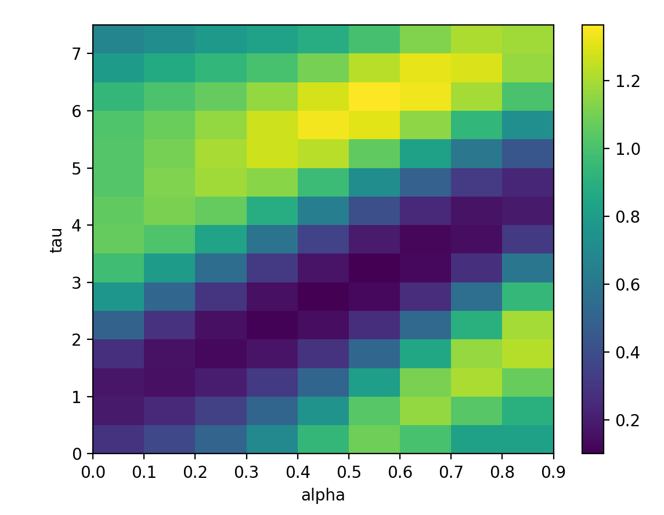
Grid Search
Section C | Modelling and model fitting
HARTLEY LAB
Log Likelihood values
Naiti Bhatt | Greer Bizzell-Hatcher | Magda Dubois
Notes:
To orient you to the graph, each axis is one parameter and the range of each axis is the range of possible values for the given parameter. The heatmap displayed shows the likelihood values, with lower values plotted as more purple and higher likelihood values plotted as more yellow. The closer to yellow, the higher the likelihood of the data given the model. These are the values we are looking to maximize.

Slide 48
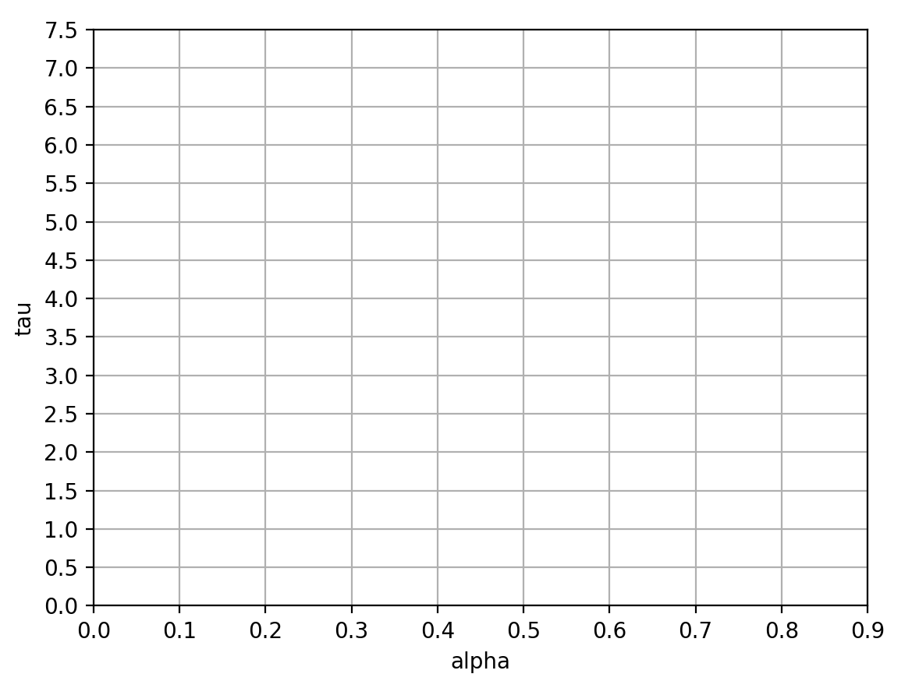
Grid Search: Example
Section C | Modelling and model fitting
HARTLEY LAB
➔ Divide parameters into grid
Naiti Bhatt | Greer Bizzell-Hatcher | Magda Dubois
Notes:
So let’s take a step back. The first step in grid search is to divide the range of parameters into a grid as shown, so we set the limits of tau and alpha in this grid. We want to iterate through the ranges of values, so we split it based on what is easy to calculate based on a scale. This is shown as the axes of the graph. I’ve chosen to split alpha by 0.1 and tau by 0.5.

Slide 49
Grid Search
Section C | Modelling and model fitting
HARTLEY LAB
➔ For each set of parameters, compute the likelihood of parameters given data
Naiti Bhatt | Greer Bizzell-Hatcher | Magda Dubois
Notes:
Then, we iterate through the values using the scale we chose. So we calculate the value for every point on this grid. So, for tau = 3 and alpha = 0.3, we calculate the likelihood of the data given the model with those parameter values. I won’t go into the specifics, as Magda already discussed how to compute the likelihood earlier. At this step, we estimate the likelihood of the data given the model.
The larger our range and smaller our scale of values, the more computationally expensive this step gets, as we have to calculate the likelihood of each intersection on the grid. At the same time, the smaller our scale, the more accurate our estimation of the maximum likelihood will be. In other words, the more data we have, the more accurate this value would be, so it is important to run more trials and have a higher amount of data to get a higher fidelity of of measure.

Slide 50
Grid Search
Section C | Modelling and model fitting
HARTLEY LAB
Log Likelihood
➔ Take the largest!
Naiti Bhatt | Greer Bizzell-Hatcher | Magda Dubois
Notes:
Finally, we can plot the outcome as a colorful grid as shown and choose the values of alpha and tau that maximize the likelihoods that we calculated.

Slide 51
Grid Search Drawbacks
Section C | Modelling and model fitting
HARTLEY LAB
Grid search is often impossible in practice
➔ especially with large ranges and more dimensions (>2)
Naiti Bhatt | Greer Bizzell-Hatcher | Magda Dubois
Notes:
Grid search is often impossible in practice with large ranges of values with small step sizes and more dimensions (e.g. more than 2 parameters)
If you have a ton of values, it is computationally very expensive to calculate each permutation of values for the parameters.

Slide 52
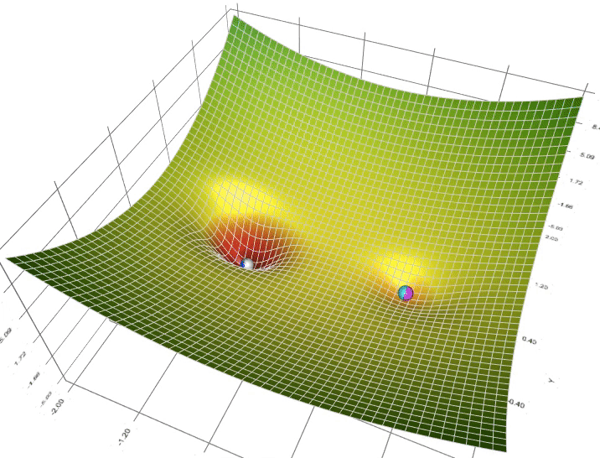
Gradient Search
Section C | Modelling and model fitting
HARTLEY LAB
➔ Look for steepest descent
➔ Note: we are minimizing NEGATIVE LOG LIKELIHOOD
e.g. fmincon (MATLAB)
optimalParams = fmincon(fct,initParams,...,bounds)
Naiti Bhatt | Greer Bizzell-Hatcher | Magda Dubois
Image from: https://towardsdatascience.com/a-visual-explanation-of-gradient-descent-methods-momentum-adagrad-rmsprop-adam-f898b102325c
Notes:
Gradient search accounts for some of the pitfalls of grid search. In this method, we plot the negative log likelihoods of the parameters given the data and search for the steepest descent on the graph. Note that we are using negative log likelihood, so we are looking minimize this value in order to maximize the likelihood. By convention, we minimize a cost function rather than maximizing, so we must convert the likelihood function to one that we can minimize.
The gradient search method is best understood using this gif, where we having a few different starting points, shown as the balls, and we follow the fastest ball to the minimum.
In MATLAB, we can use fmincon to do this.

Slide 53

Aside: Local and Global Minima
Section C | Modelling and model fitting
HARTLEY LAB
Negative Log Likelihood
Naiti Bhatt | Greer Bizzell-Hatcher | Magda Dubois
Image from: https://bdtechtalks.com/2020/04/27/deep-learning-mode-connectivity-adversarial-attacks/gradient-descent-local-minima/
Notes:
The functions we are minimizing are often nonlinear. If we plot these functions, we get a bumpy surface that varies in function values. This texture leads to local and global minima. Local minima are where the function values dip, so where the function value is smaller than at nearby points, but not at the lowest point. The global minimum is the lowest possible point, or the point at which the function value is the lowest out of all possible values outputted by the function. The global minimum is the value that we want, with that, we can truly minimize log likelihood, rather than minimizing locally based on the bumps on the surface of the function. If you were to imagine doing gradient descent on this surface, it is clear that the starting point will impact whether or not we get to the global minimum. If we start at A, our closest descent will be at the nearby local minimum. As a result, it’s really important to choose your starting value wisely.

Slide 54
Gradient Search Drawbacks
Section C | Modelling and model fitting
HARTLEY LAB
➔ Starting point affects outcome
➔ Sometimes, does not converge
➔ BUT, plotting log likelihood surface helps show what is going on
Negative Log Likelihood
Naiti Bhatt | Greer Bizzell-Hatcher | Magda Dubois
Image from: https://bdtechtalks.com/2020/04/27/deep-learning-mode-connectivity-adversarial-attacks/gradient-descent-local-minima/
Notes:
This leads us to the drawbacks of gradient search.
As we discussed in the previous slide, different starting points affect the outcome: depending on where we choose our starting point, we can end up in a local minimum of the surface instead of the global minimum of the lowest value of log likelihood.
In other situations, we might reach the maximum number of iterations and the value might not converge to a minimum. Imagine your starting point has no steepness and the ball does not roll at all and kind of just lobs around.
Note that you can always plot the log likelihood surface to understand what’s going on and to see if you might be ending up in a local minimum or stuck at a point with no steepness.

Slide 55
Optimization under constraints
Section C | Modelling and model fitting
HARTLEY LAB
Grid search and gradient search are both optimization under constraints
➔ Constraints (range of parameters):
Dictated by the task (e.g. learning rate (ɑ) < 1)
Ones that makes sense (e.g. inverse temperature (τ))
Naiti Bhatt | Greer Bizzell-Hatcher | Magda Dubois
Notes:
There are lots of different ways of doing optimization, gradient descent with fmincon is error prone but fast, other methods like mcmc or genetic algorithms are slower.
Overall, we’ve looked at two different methods of optimization under constraints. We constraint our initial values and search within our constrained values of parameters.
We can have constraints based on the task. For example, learning rate needs to be positive, and is constrained as such because otherwise there is too much oscillation in the model values.
We also have constraints based on what makes sense, like inverse temperature. As noted earlier, depending on the degree to which value estimates influence choices, we can choose intuitive values for inverse temperature.
high inverse temperatures indicate that individuals tend to select the higher-value option while low inverse temperatures indicate that value differences between options govern choices to a lesser extent.

Slide 56
Summary
Section C | Modelling and model fitting
HARTLEY LAB
Goal: find the parameters which maximize the likelihood of observing the data
Cannot be solved analytically in RL → numerical methods:
Grid search: very heavy computationally
Best → Gradient methods (e.g. fmincon in MATLAB)
Alternatives: MCMC and genetic algorithms (slower)
Naiti Bhatt | Greer Bizzell-Hatcher | Magda Dubois
Notes:
In summary, we’ve reviewed methods of model fitting and parameter estimation in this section. Our goal is to find the parameters that maximize the likelihood of the parameter values that make the model best fit the data. This cannot be solved analytically in reinforcement learning and computational modeling, so we turn to numerical methods of parameter estimation and optimization. We reviewed computationally expensive methods like grid search, but would like to underscore that the best methods of parameter estimation are gradient methods using functions like fmincon in MATLAB and statistical methods that allow for comparisons like maximum likelihood estimation. It’s important to note that the methods we cover today are not the only methods that exist for optimization. Other methods, like MCMC and genetic algorithms can achieve the same result, but they tend to be slower than the methods we discussed today. Thank you for listening and we this was helpful!

Slide 57
Resources
Section C | Modelling and model fitting
HARTLEY LAB
http://www.kris-nimark.net/pdf/NumMaxSlides.pdf
http://www.hannekedenouden.ruhosting.nl/RLtutorial/html/GridSearchSimData.html
Naiti Bhatt | Greer Bizzell-Hatcher | Magda Dubois

Slide 58
Appendix
Workshop No. | Modelling and model fitting
HARTLEY LAB
Naiti Bhatt | Greer Bizzell-Hatcher | Magda Dubois

Slide 59
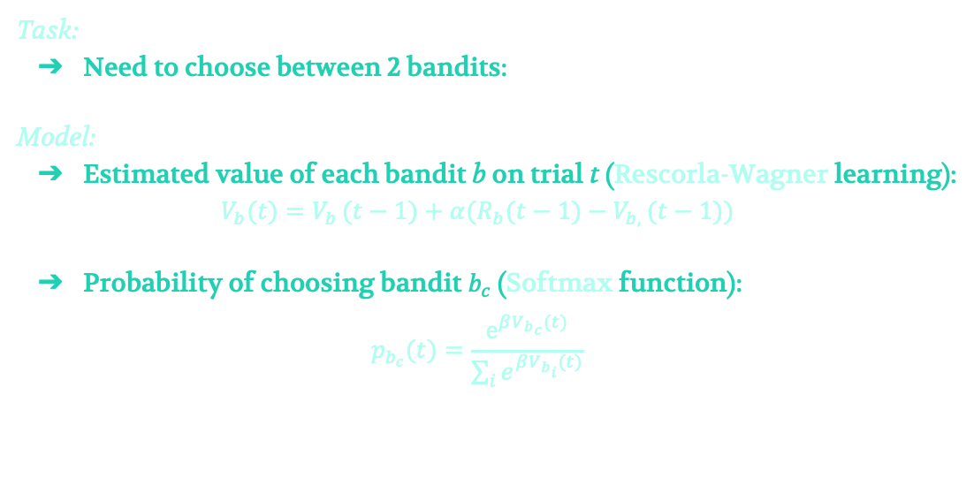
Reminder
Workshop No. | Session Length | Modelling and model fitting
HARTLEY LAB
Naiti Bhatt | Greer Bizzell-Hatcher | Magda Dubois

Slide 60
Likelihood
Introduce Bayes etc
(not needed probably)
Consider 2 random variables X and Y
Probability of x and y: Joint probability
Product rule = p(x,y) = p(y|x)p(x)
(1st term is: probability of y given x: Conditional probability)
Probability of x: Marginal probability
sum rule = p(x) + sum_y p(x,y)
p.15 Bishop
Notes:
Likelihood is like reducing the RMSE, Ordinary least squares (likelihood is a more general way no need to be contstrained)
No need to get into the details in Bayes

Slide 61
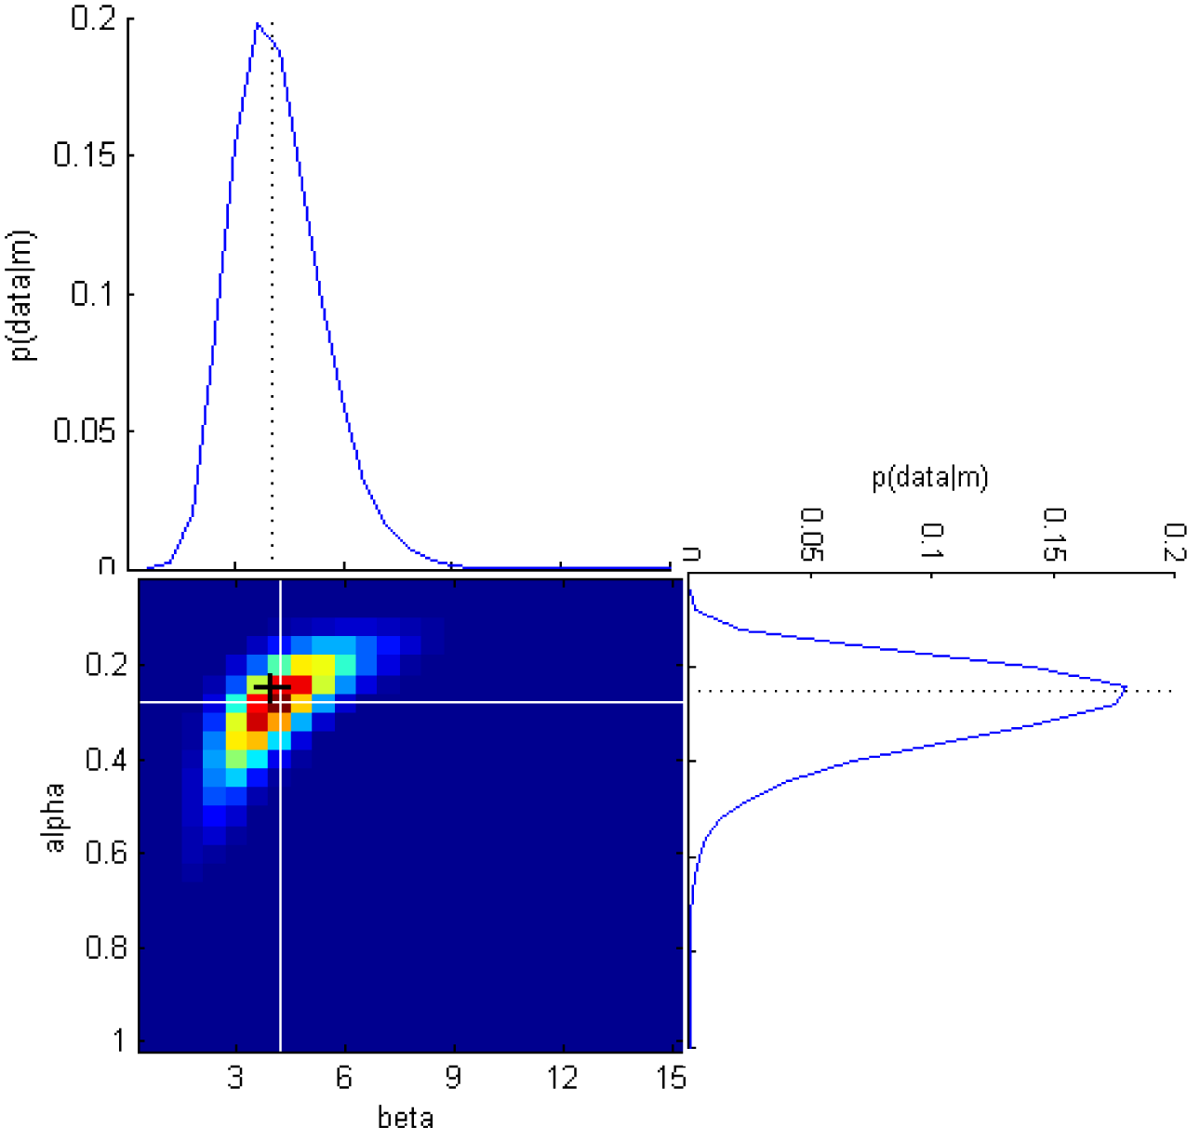
(Marginal distributions)
We are interested in the value of each parameter 🡪 For each dimention we collapse over the other dimension
Maximum likelihood estimate: value of parameter at the highest likelihood (peak of ditribution)

Slide 62
Notes
Link between RMSE and MLE? (see Bishop)
MLE: maximizes the likelihood of the model given the data. Entirely statistical + a metrics to compare models
Difference between cond prob and likelihood?

Slide 63
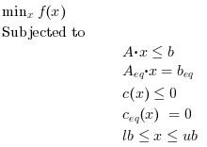
fmincon: minimize constrained nonlinear multivariable function
Where
A and A_{eq} are matrices
b and b_{eq} are vectors
c(x) and c_{eq}(x) return vectors
f(x) returns a scalar
f(x), c(x), and c_{eq}(x) can be nonlinear
x, lb, and ub can be vectors or matrices

Slide 64
● What are they, what’s their role? How to understand them
● Types of parameter
o fixed
o free: estimated during model fitting

Slide 65
● (Linear model: Least square: minimizes the RMSE between model and data (grpA?)) -- check book for the link
● Bayes, statistics, scrappy def of likelihood
● RW=softmax model: MLE: maximizes the likelihood of the model given the data. Entirely statistical + a metrics to compare models
● Log, neg. Difference between cond.prob et likelihood

Slide 66
What is parameter optimisation?
The problem of choosing optimal parameters for an algorithm
Goal: minimize loss

Slide 67
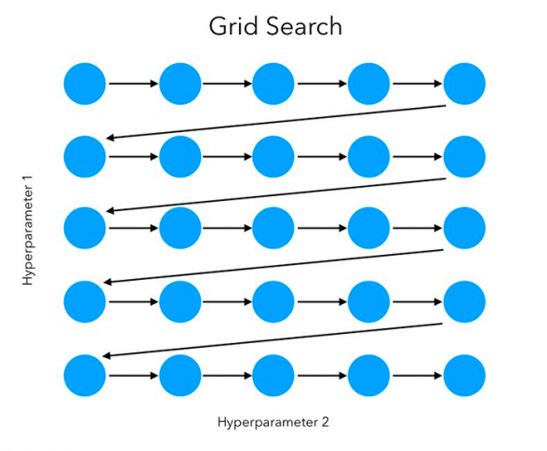
Grid Search (a.k.a. Parameter Sweep)
Exhaustive search with prespecified parameters
Computationally expensive!
Image from https://www.pyimagesearch.com/2021/05/24/grid-search-hyperparameter-tuning-with-scikit-learn-gridsearchcv/.
Notes:
We take two parameters, usually one that is important and one that is not, and we search for the optimal values of these parameters. We maximize log likelihood or minimize root mean squared standard deviation to fit the best model!

Slide 68
● Grid search: plot param1, param2, RMSD or LL - min: best fitting model
● Often impossible in practice:
o Constrained optimisation: fmincon - visualization (Luigi Acerbi github?)
o Local vs Global minima (use different starting points)
● Likelihood => to find best parameters (bayes)
● (Pitfalls - not a good sign if touches the bounds (link with fmincon)
o Ex. Temperature -> not trivial (unlike learning rate)
o Aberrant values?
complexity?

Slide 69
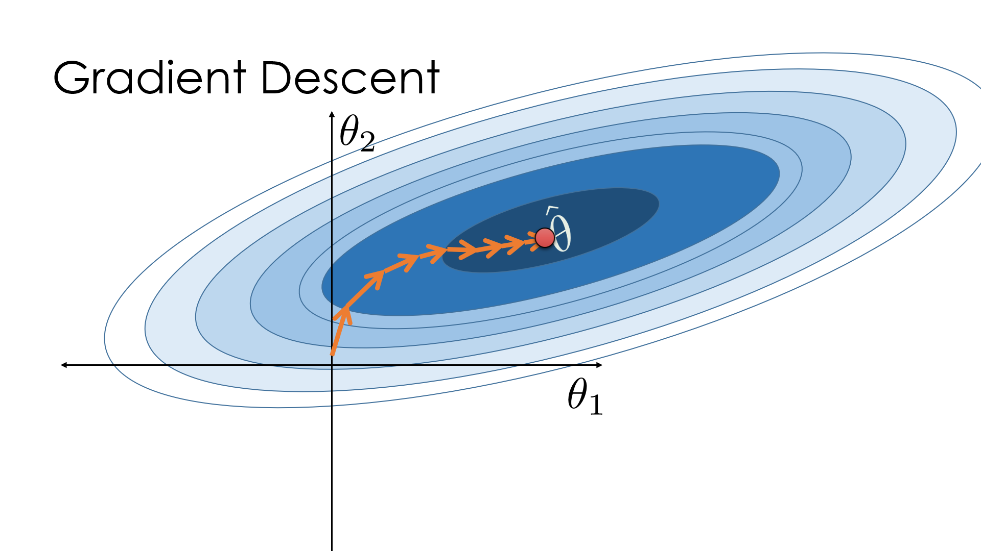
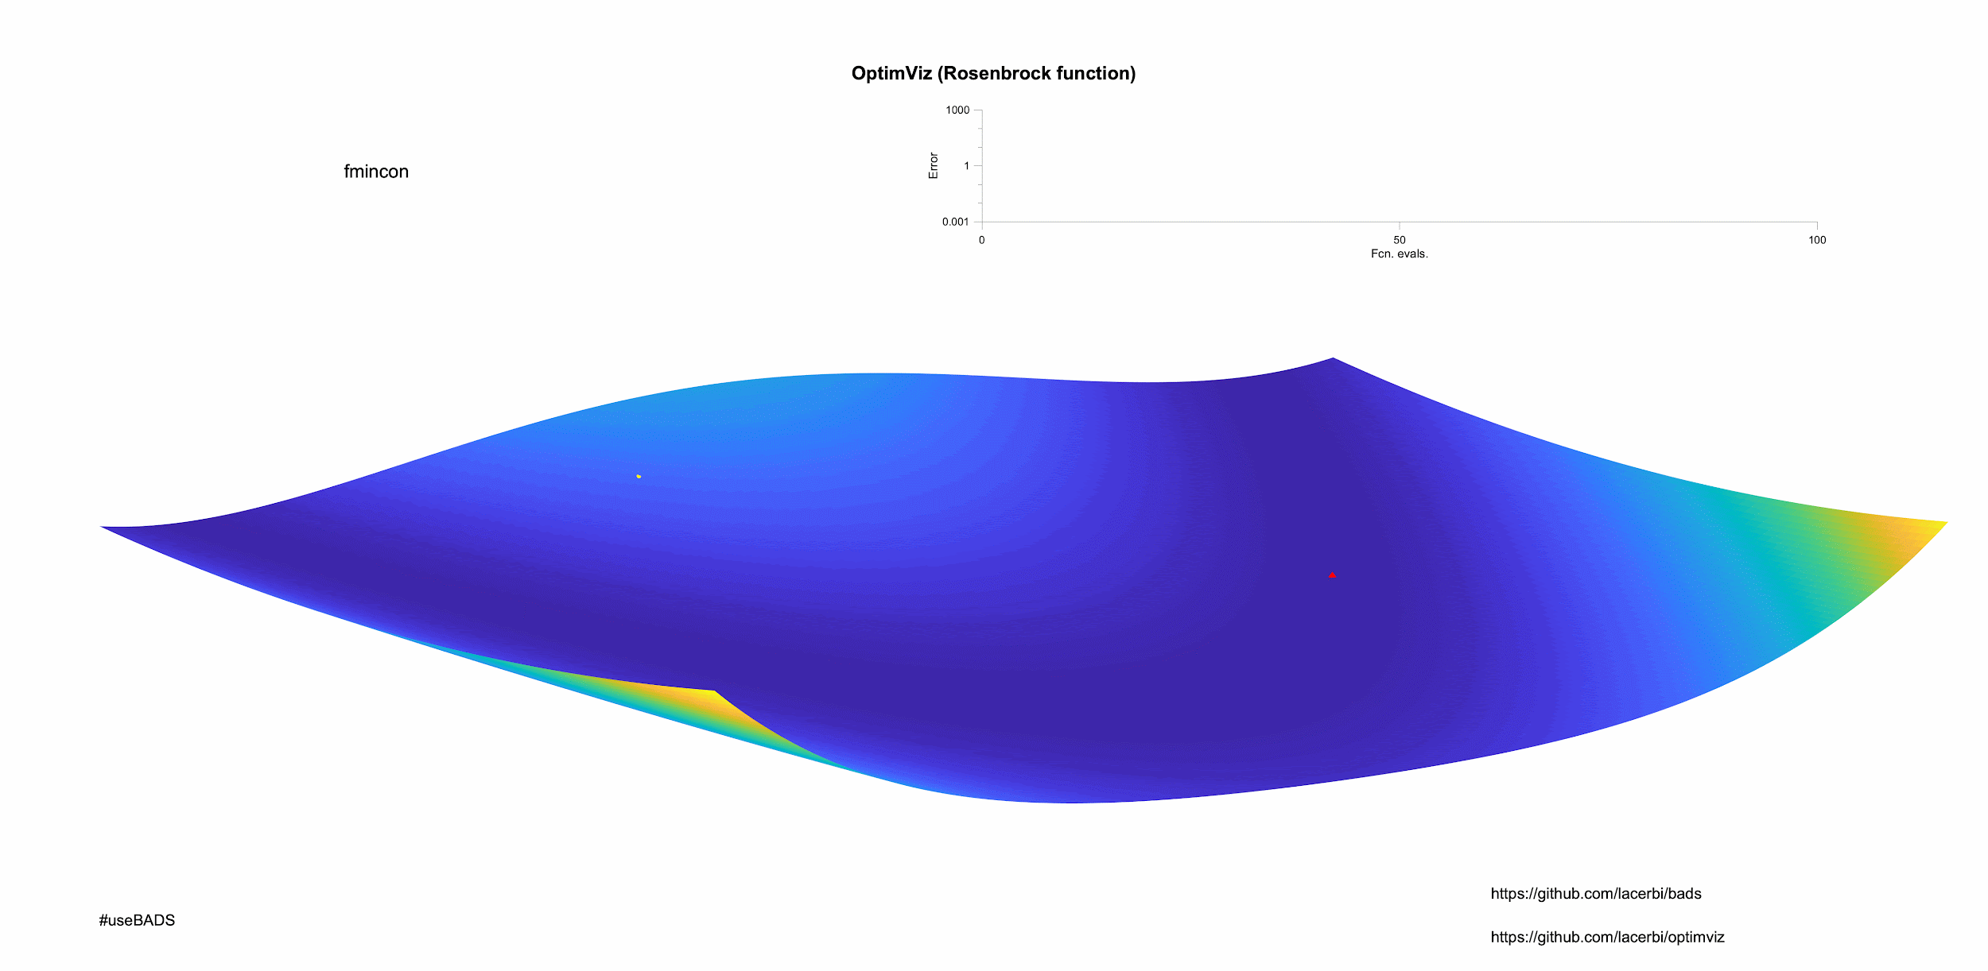
In MATLAB: fmincon
Image from: https://vitalflux.com/local-global-maxima-minima-explained-examples/.

